Slide 1
Stock Market Analysis Dashboard Project
Tkinter GUI
Notes:
Entered text
Stock Market Analysis Dashboard Project
Project Overview:
This project involves creating a Stock Market Analysis Dashboard using Tkinter, yfinance,
pandas, and matplotlib. The dashboard allows users to input stock symbols, select a date
range, and analyze the stock's performance. TProject Structure:
• Main Script:
o File: stock_market_analysis.py
o Description: Contains the main code for the Stock Market Analysis
Dashboard.
• Dependencies:
o tkinter: GUI library for creating the user interface.
o yfinance: Fetches stock data from Yahoo Finance.
o pandas: Handles and manipulates the stock data.
o matplotlib: Plots the stock price data.
o tkcalendar: Provides a date entry widget for Tkinter.
• Features:
o Input for multiple stock symbols (comma-separated).
o Date range selection using a calendar widget.
o Plots the closing prices of selected stocks.
o Displays performance metrics such as percentage change, daily return, and
average volume.
• Usage:
o Execute the script stock_market_analysis.py.
o Enter stock symbols, select a date range, and click the "Analyze" button.
o View the plotted stock prices and performance metrics.
• Project Files:
o stock_market_analysis.py: Main script.
o Any additional files (if used) like images, icons, or configuration files.
Analysis:
1. Motivation for Choosing the Project:
• Real-Time Analysis: Today's financial markets operate in real-time, and investors require timely
and accurate information.
User-Friendly Interface: Existing systems might lack a user-friendly interface, making it
challenging for users, especially those without a financial background, to analyze stock data
effectively.
2. Drawbacks in Existing Concept:
• Complexity: Some systems might be overly complex, making it difficult for users to navigate and
extract relevant information.
• Limited Features: Older systems may lack modern features, such as interactive visualizations,
dynamic date range selection, or performance metrics, limiting the depth of analysis users can
perform.
Outcomes:
• Enhanced User Experience: The project significantly improves the user experience
compared to existing systems, offering a more accessible and visually engaging platform for
stock market analysis.
• Modernized Technology Stack: By integrating modern libraries such as yfinance, pandas,
and tkcalendar, the project utilizes contemporary tools, ensuring efficiency, accuracy, and
security in data retrieval, manipulation, and date selection

Slide 2
Project Overview
This project involves creating a Stock Market Analysis Dashboard using Tkinter, yfinance, pandas, and matplotlib.
The dashboard allows users to input stock symbols, select a date range, and analyze the stock's performance
The analysis includes plotting the closing prices over the specified date range and displaying performance metrics such as percentage change, daily return, and average volume.

Slide 3
Stock Market Analysis Dashboard Project
This project involves creating a Stock Market Analysis Dashboard using Tkinter, yfinance, pandas, and matplotlib. The dashboard allows users to input stock symbols, select a date range, and analyze the stock's performance.

Slide 4
Tkinter in Python
Tkinter is a Python library used to construct graphical user interfaces (GUIs).
It empowers developers to design interactive applications by providing widgets and tools. Commonly utilized in project dashboards, Tkinter enables the creation of user-friendly interfaces for tasks like data analysis and visualization.
Its simplicity and integration with Python make it a popular choice for building GUI-based applications.

Slide 5
Data Analysis and Plotting
Use pandas to process and analyze the downloaded stock data
Utilize Matplotlib to create dynamic plots within the Tkinter interface
Update plots based on user-selected stock symbols and date range

Slide 6
Project Overview
This project involves creating a Stock Market Analysis Dashboard
Users can select a date range and analyze the stock's performance
The dashboard allows users to input stock symbols
The dashboard is built using Tkinter, yfinance, pandas, and matplotlib

Slide 7
Project Structure
Main Script: stock_market_analysis.py
Dependencies: tkinter, yfinance, pandas, matplotlib, tkcalendar
Features: input for multiple stock symbols, date range selection, plot closing prices, display performance metrics

Slide 8
Structure
Usage:
Execute the script stock_market_analysis.py.
Enter stock symbols, select a date range, and click the "Analyze" button.
View the plotted stock prices and performance metrics
Main Script:
File: stock_market_analysis.py
Description: Contains the main code for the Stock Market Analysis Dashboard.
Features:
Input for multiple stock symbols (comma-separated).
Date range selection using a calendar widget.
Plots the closing prices of selected stocks
Displays performance metrics such as percentage change, daily return, and average volume.
Libraries:
. Tkinter
. Yfinance
. Pandas
. Matplotlib
. tkcalendar

Slide 9
Dependencies
pandas: Handles and manipulates the stock data.
tkinter: GUI library for creating the user interface.
yfinance: Fetches stock data from Yahoo Finance.
matplotlib: Plots the stock price data.
tkcalendar: Provides a date entry widget for Tkinter.

Slide 10
GUI Design
Create a main window using Tkinter
Design frames, labels, entry fields, and buttons for user interaction
Plan the layout to accommodate stock symbol input, date range selection, and performance metric display

Slide 11
Drawbacks in Existing Concept
Limited Features
Older systems may lack modern features, such as interactive visualizations, dynamic date range selection, or performance metrics, limiting the depth of analysis users can perform.
Outdated Technology
Legacy systems may be built on outdated technologies, leading to slower performance and potential security vulnerabilities.
Complexity
Some systems might be overly complex, making it difficult for users to navigate and extract relevant information.

Slide 12
Usage
Execute the script stock_market_analysis.py
Enter stock symbols, select a date range, and click the 'Analyze' button
View the plotted stock prices and performance metrics

Slide 13
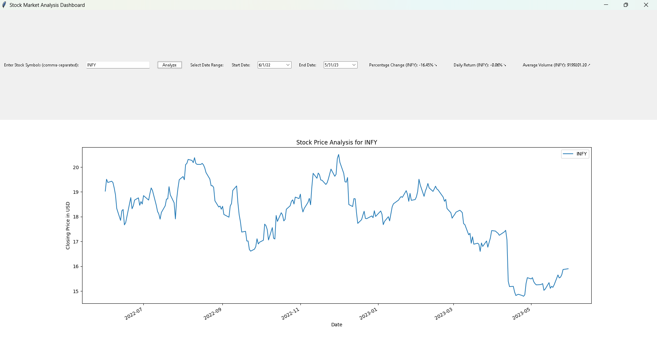
Project sample

Slide 14
Analysis
Real-Time Analysis
Today's financial markets operate in real-time, and investors require timely and accurate information.
User-Friendly Interface
Existing systems might lack a user-friendly interface, making it challenging for users, especially those without a financial background, to analyze stock data effectively.
Drawbacks in Existing Concept
Complexity: Some systems might be overly complex, making it difficult for users to navigate and extract relevant information.
Limited Features: Older systems may lack modern features, such as interactive visualizations, dynamic date range selection, or performance metrics, limiting the depth of analysis users can perform.

Slide 15
Findings
Dynamic Visualizations
The use of Matplotlib facilitates dynamic and interactive visualizations, empowering users to analyze stock prices for multiple symbols simultaneously. The inclusion of performance metrics offers a comprehensive view of stock performance.
Efficient Data Retrieval
The integration of the yfinance library enables swift and reliable retrieval of historical stock data from Yahoo Finance, ensuring that users have access to uptodate information
Error Handling
The implementation of error handling mechanisms ensures that users are informed of any data retrieval issues, contributing to transparency and enhancing the overall user experience.
User-Friendly Interface
The Tkinter-based graphical user interface provides an intuitive and user-friendly experience, allowing users to easily input stock symbols, select date ranges, and interpret the visualized data.

Slide 16
Outcomes
Enhanced User Experience: The project significantly improves the user experience compared to existing systems, offering a more accessible and visually engaging platform for stock market analysis.
Modernized Technology Stack: By integrating modern libraries such as yfinance, pandas, and tkcalendar, the project utilizes contemporary tools, ensuring efficiency, accuracy, and security in data retrieval, manipulation, and date selection.

Slide 17
Results
Holistic Stock Analysis:
The Stock Market Analysis Dashboard successfully consolidates stock data, allowing users to analyze multiple stocks in one centralized location.
Performance Metrics:
The inclusion of percentage change, daily return, and average volume metrics enables users to assess the financial performance of selected stocks, enhancing their decision-making process.
The dynamic visualizations provide a comprehensive overview of stock prices over user-selected date ranges.
The project empowers users, regardless of their financial expertise, to make informed decisions by providing a user-friendly interface and meaningful visualizations.
User Empowerment:

